Slide 1
Standard path of machine learning project
By : Himanshu Shukla (Data Scientist)

Slide 2
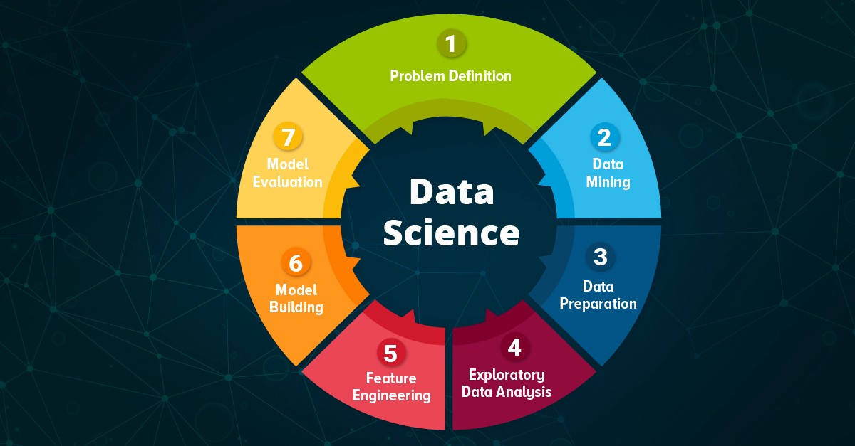

Slide 3
Machine learning development life cycle
1) Frame the Problem
2) Gathering Data
Csv
API fetching
3) EDA
Univariate Analysis
Bivariate Analysis
Web scraping
Databases-via ETL
Big data ( spark)
Multivariate Analysis
Visualization
Imbalance data correction
5) Feature Engineering
6) Model Training , Evaluation and selection
Algorithm/Model selection
Parameter tuning
7) Model Deployment
Heroku
Aws
GCP
8) Testing
A/B testing
9) Optimize
Lots of thing

Slide 4
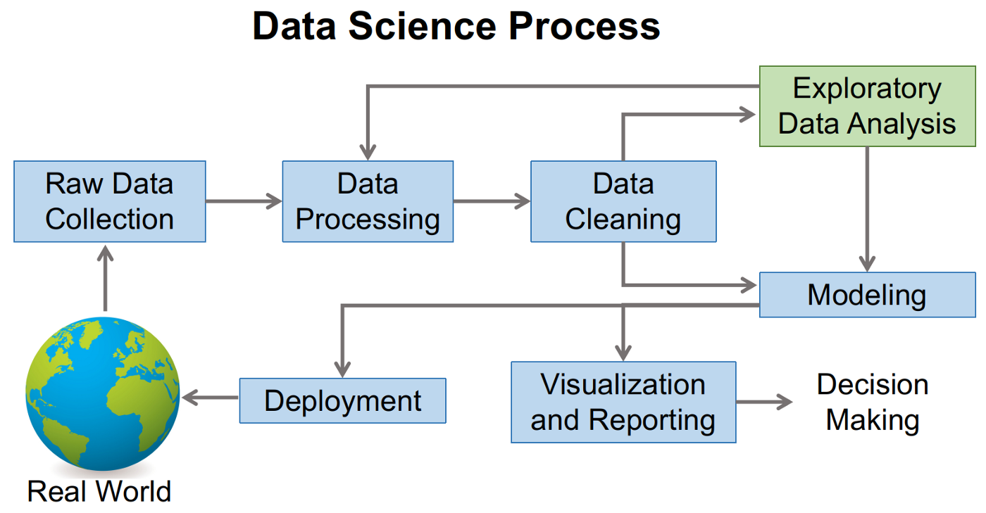

Slide 5
1.
First Step after importing data
Let’s start by Asking 7 Quetions

Slide 6
“By these pandas inbilt functions, we can get basic info of our data ”
Q.1 How big is the data
Q.3 What is the data type of columns
-> df.shape
Q.2 How does the data looks like
Q.4 Are there any missing values
Q.5 how does the data look mathematically?
Q.6 Are there duplicate values
Q.7 How is the correlation b/w variables?
-> df.head
-> df. sample(50
-> df.info( )
-> df.dtypes()
-> df.isnull().sum()
-> df.describe( )
-> df.duplicated().sum()
-> df.dropduplicate()
->df.corr( )[“y”] {Pearson Corr. Coefficient}

Slide 7
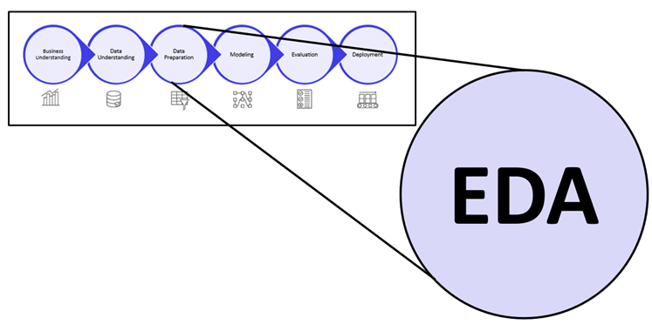
2. EDA (exploratory data analysis)

Slide 8
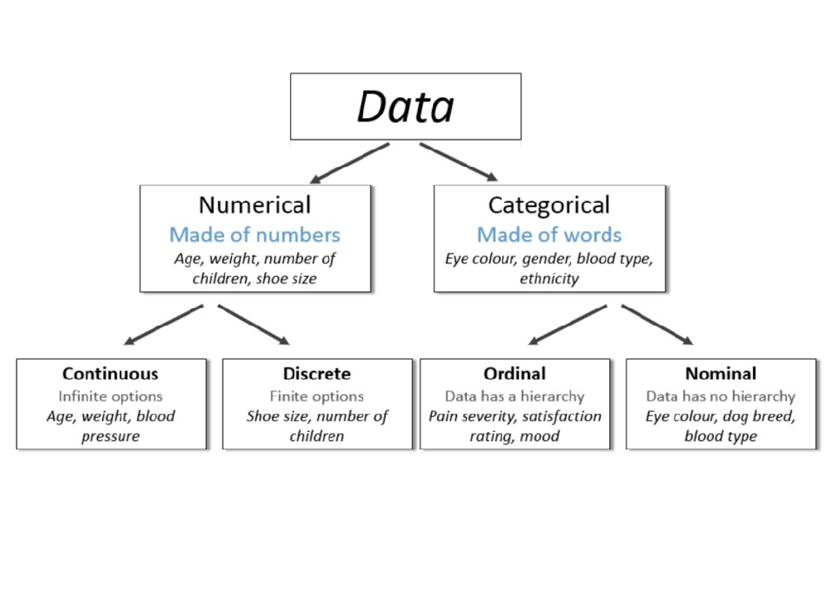
EDA
LOREM 3
Multivariate Analysis
LOREM 1
Univariate Analysis
EDA
LOREM 2
Bivariate Analysis

Slide 9
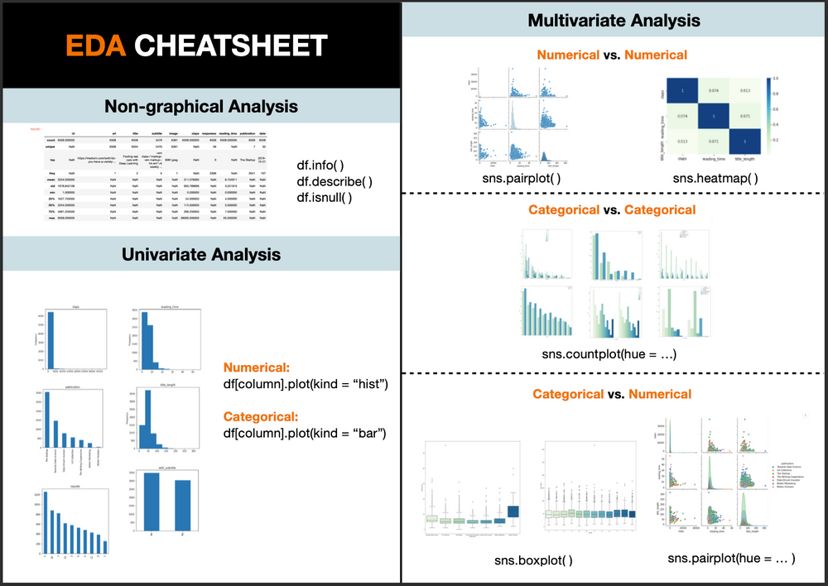

Slide 11
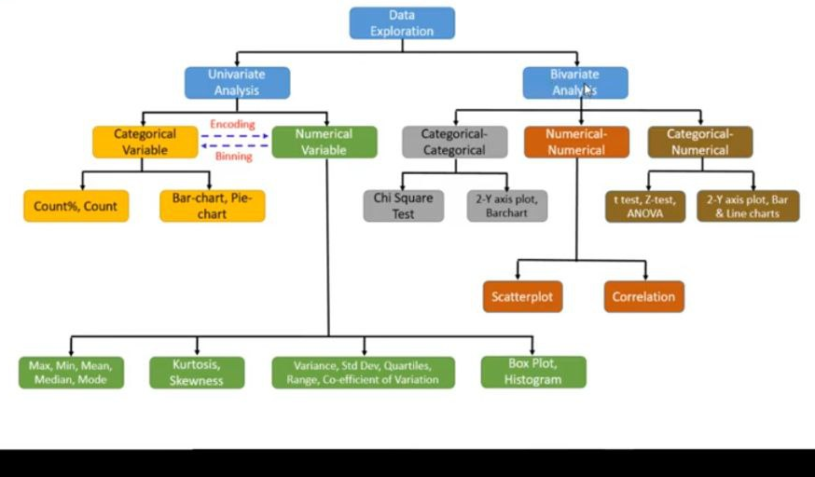

Slide 12
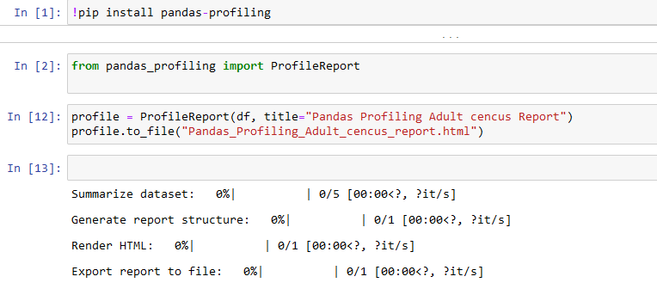
Smart work
Use pandas profiling

Slide 13

Hello!
I am Himanshu Shukla
I am here because I love Data Scientist.
You can find me at himanshu.shukla.him@gmail.com

